Slide 1
CCNA 200-301, Volume 2
Advanced IPv4 Access Control Lists

Slide 2
Objectives
Configure and verify access control lists

Slide 3
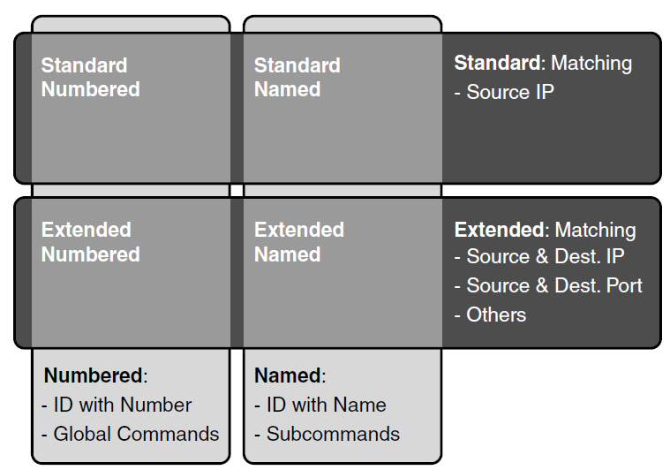
Comparisons of IP ACL Types

Slide 4
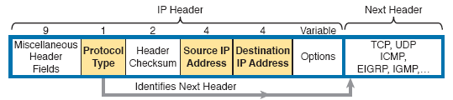
IP Header, with Focus on Required Fields in Extended IP ACLs

Slide 5
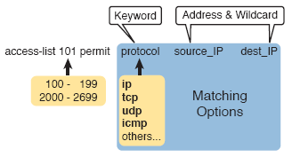
Extended ACL Syntax, with Required Fields

Slide 6
Extended access-list Commands and Logic Explanations
access-list Statement | What it Matches
access-list 101 deny tcp any any | Any IP packet that has a TCP header
access-list 101 deny udp any any | Any IP packet that has a UDP header
access-list 101 deny icmp any any | Any IP packet that has an ICMP header
access-list 101 deny ip host 1.1.1.1 host 2.2.2.2 | All IP packets from host 1.1.1.1 going to host 2.2.2.2, regardless of the header after the IP header
access-list 101 deny udp 1.1.1.0 0.0.0.255 any | All IP packets that have a UDP header following the IP header, from subnet 1.1.1.0/24, and going to any destination

Slide 7
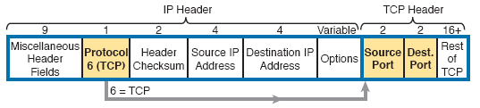
IP Header, Followed by a TCP Header and Port Number Fields

Slide 8
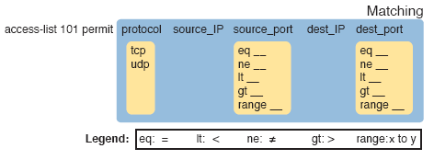
Extended ACL Syntax with TCP and UDP Port Numbers Enabled

Slide 9
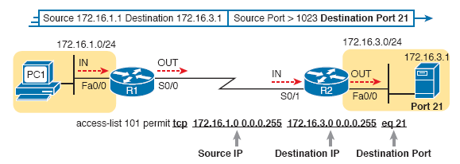
Filtering Packets Based on Destination Port

Slide 10
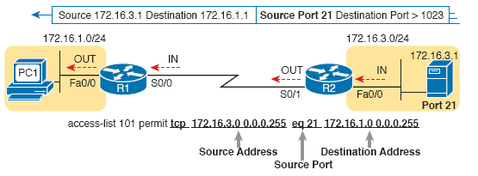
Filtering Packets Based on Source Port

Slide 11
Popular Applications and Their Well-Known Port Numbers
Port Number(s) | Protocol | Application | access-list Command Keyword
20 | TCP | FTP Data | ftp-data
21 | TCP | FTP control | ftp
22 | TCP | SSH | --
23 | TCP | Telnet | telnet
25 | TCP | SMTP | smtp
53 | UDP, TCP | DNS | domain
67 | UDP | DHCP Server | bootps
68 | UDP | DHCP Client | bootpc

Slide 12
Popular Applications and Their Well-Known Port Numbers (continued)
Port Number(s) | Protocol | Application | access-list Command Keyword
69 | UDP | TFTP | tftp
80 | TCP | HTTP (WWW) | www
110 | TCP | POP3 | pop3
161 | UDP | SNMP | snmp
443 | TCP | SSL | --
514 | UDP | Syslog | --
16,384-32,767 | UDP | RTP (Voice, Video) | --

Slide 13
Extended access-list Command Examples and Logic Explanations
access-list Statement | What It Matches
access-list 101 deny tcp any gt 49151 host 10.1.1.1 eq 23 | Packets with a TCP header, any source IP address, with a source port greater than (gt) 1023, a destination IP address of exactly 10.1.1.1, and a destination port equal to (eq) 23.
access-list 101 deny tcp any host 10.1.1.1 eq 23 | The same as the preceding example, but any source port matches, because that parameter is omitted in this case.
access-list 101 deny tcp any host 10.1.1.1 eq telnet | The same as the preceding example. The telnet keyword is used instead of port 23.
access-list 101 deny udp 1.0.0.0 0.255.255.255 lt 1023 any | A packet with a source in network 1.0.0.0/8, using UDP with a source port less than (lt) 1023, with any destination IP address.

Slide 14
Extended IP Access List Configuration Commands
Command | Configuration Mode and Description
access-list access-list-number {deny | permit} protocol source source-wildcard destination destination-wildcard [log | log-input] | Global command for extended numbered access lists. Use a number between 100 and 199 or 2000 and 2699, inclusive.
access-list access-list-number {deny | permit} {tcp | udp} source source-wildcard [operator [port]] destination destination-wildcard [operator [port]] [established] [log] | A version of the access-list command with parameters specific to TCP and/or UDP.

Slide 15
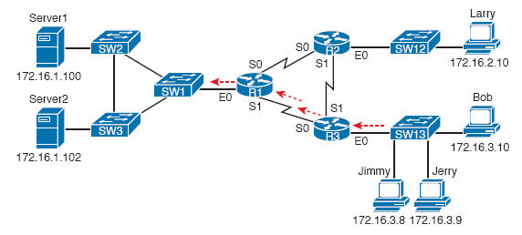
Network Diagram for Extended Access List Example 1

Slide 16
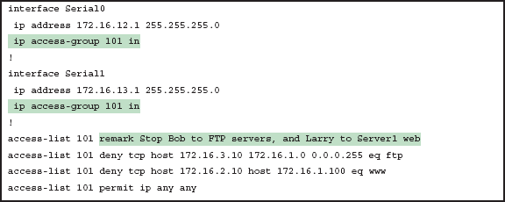
R1’s Extended Access List: Example 1

Slide 17
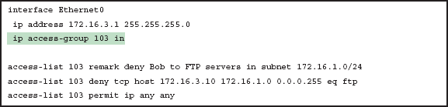
R3’s Extended Access List Stopping Bob from Reaching FTP Servers Near R1

Slide 18
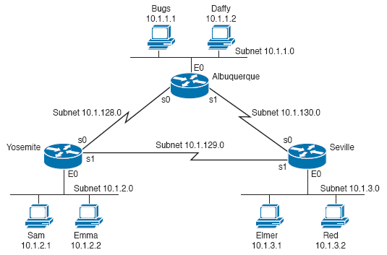
Network Diagram for Extended Access List Example 2

Slide 19
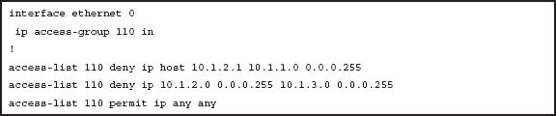
Yosemite Configuration for Extended Access List Example 2

Slide 20
Building One-Line Extended ACLs: Practice
Problem | Criteria
1 | From web client 10.1.1.1, sent to a web server in subnet 10.1.2.0/24.
2 | From Telnet client 172.16.4.3/25, sent to a Telnet server in subnet 172.16.3.0/25. Match all hosts in the client’s subnet as well.
3 | ICMP messages from the subnet in which 192.168.7.200/26 resides to all hosts in the subnet where 192.168.7.14/29 resides.
4 | From web server 10.2.3.4/23’s subnet to clients in the same subnet as host 10.4.5.6/22.
5 | From Telnet server 172.20.1.0/24’s subnet, sent to any host in the same subnet as host 172.20.44.1/23.

Slide 21
Building One-Line Extended ACLs: Practice (continued)
Problem | Criteria
6 | From web client 192.168.99.99/28, sent to a web server in subnet 192.168.176.0/28. Match all hosts in the client’s subnet as well.
7 | ICMP messages from the subnet in which 10.55.66.77/25 resides to all hosts in the subnet where 10.66.55.44/26 resides.
8 | Any and every IPv4 packet.

Slide 22
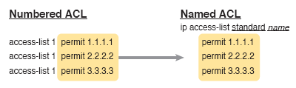
Named ACL vs. Numbered ACL Configuration

Slide 23
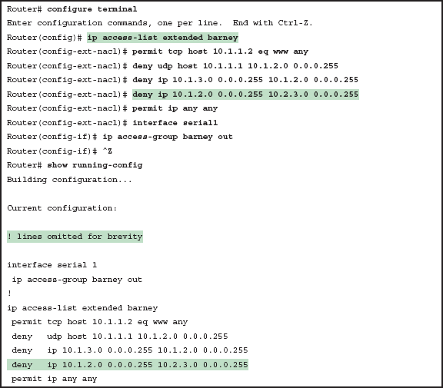
Named Access List Configuration

Slide 24
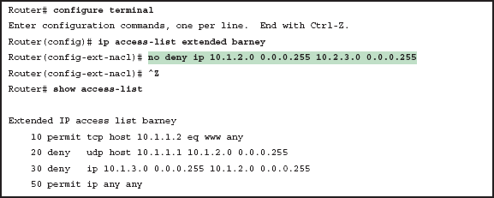
Removing One Command from a Named ACL

Slide 25
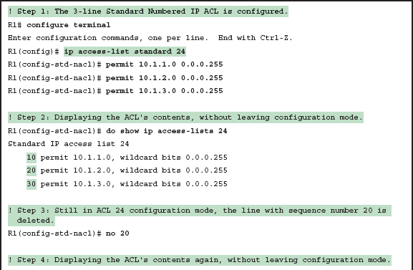
Editing ACLs Using Sequence Numbers

Slide 26
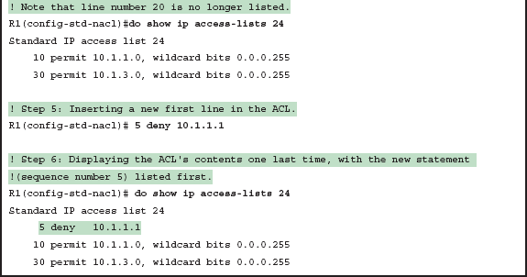
Editing ACLs Using Sequence Numbers (continued)

Slide 27
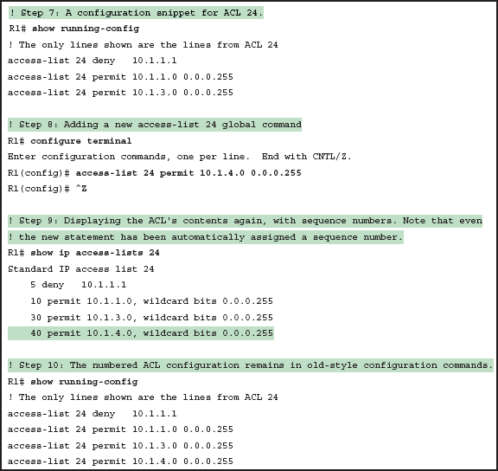
Adding To and Displaying a Numbered ACL Configuration

Slide 28
General Recommendations for ACL Implementation
Place extended ACLs as close as possible to the source of the packet.
Place standard ACLs as close as possible to the destination of the packet.
Place more specific statements early in the ACL.
Disable an ACL from its interface (using the no ip access-group interface subcommand) before making changes to the ACL.

